Slide 1
Problems faced by New Immigrants
Do Now-Give 3 problems the “new immigrants” will face in the US? (handing in 1 sheet for the partnership!)
Labor competition
Language barriers/illiterate
Poverty
Overcrowded ghettos
Religious differences- Catholic/Jewish
“American” Resistance

Slide 2
Nativist Movement
Who were they?
Some rich
Mainly the working class already here… why this group?
Reasons they hated immigrants
Immigrants took their jobs
Immigrants ↓the pay scale
“new” immigrants (SE Europe) were poor “stock” (ethnocentrism)
Different culture, language, religion
Urban blight
poor
ghettos/overpopulating the country
↑alcohol
Pollution
crime
High birthrate for immigrants
More future voting power, more Catholics in power
↑corruption in government
Brought anarchism, socialism, communism to US

Slide 3
Organizations
Know-Nothing Party (American Party) 1850s
American Protective Association (APA)1887-1897
3.5 million members
Mainly anti-Catholic- initiation was swearing to not hire Catholics, not vote for Catholics, etc.
Promoted literature about sexy nuns and priests who abused children
2nd wave of KKK in 1920s
They now hate everyone that’s not a WASP!!
Immigration Restriction League- Henry Cabot Lodge (US Senator)

Slide 4
Nativist Laws
Literacy tests for immigrants- IRL sponsored
30 words in any language to become US citizen
1882- banned broke immigrants
1885- banned contract labor importers
many after WWI- we will do them later……

Slide 5
Ethnic Specific Nativism
1882- Chinese Exclusion Act
Banned Chinese immigrants
If any Chinese in US leave, they cannot return
Chinese couldn’t marry whites/separate schools etc.
Lasts until 1943
Side effect!!! – Japanese immigration increased
Gentlemen’s Agreement 1907
Informal (never passed by Congress) deal between US and Japan
US would be nice to Japanese students already here, allow them integration in the public schools
BUT Japan would not allow their citizens to come to US

Slide 6
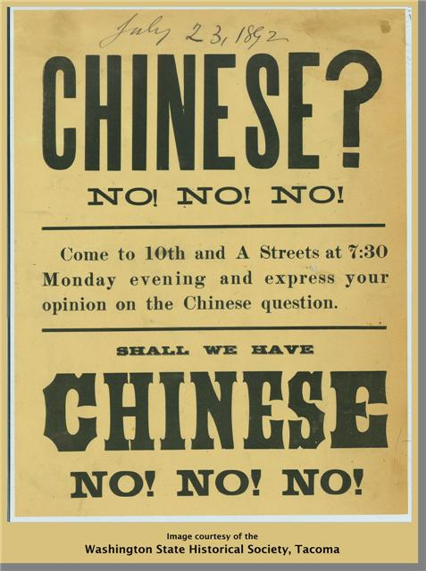
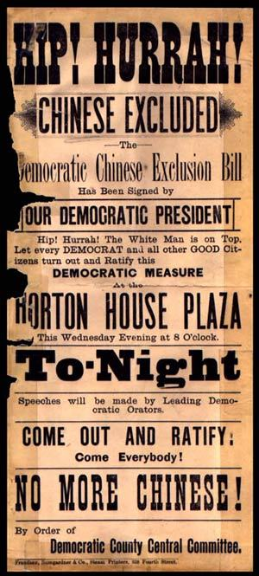

Slide 8
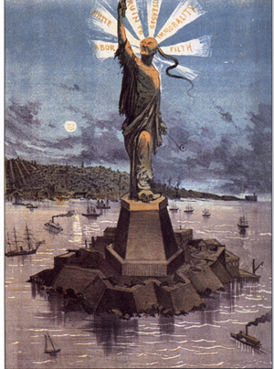

Slide 9
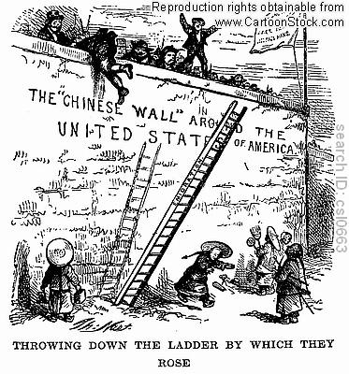

Slide 10
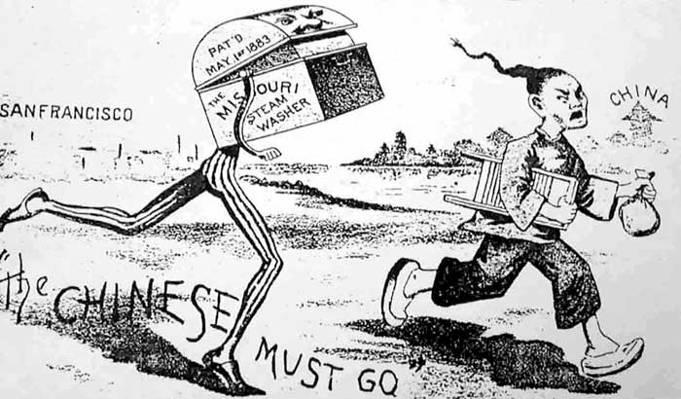

Slide 11
Modern Day Similarities????
2016 Presidential Election
History repeating itself??????
Everyone that thinks Trump and his immigration policy is new, never opened up a US history book!!

Slide 12
Hochman Exit Slip
The Nativists tried to limit immigration because
The Nativists tried to limit immigration but
The Nativists tried to limit immigration so

