Slide 1
Do Now
1. Why were the late 1800’s nicknamed the Gilded Age?
2. What specific people or events in the U.S. would be proof that the Gilded Age term fits?

Slide 2
US Grant as President
Election of 1868
Grant (Rep.) vs. Horatio Seymour (Dem)
“wave the bloody shirt”- what does this mean?
Always good to be a war hero!!
Grant wins 214-80, but close pop. Vote
More whites voted for Seymour, and 3 states didn’t have their votes counted in the South

Slide 3
Grant Scandals
“Era of Good Stealings”
“Black Friday” (1869)
Jay Gould tries to corner gold market
Bribes Grant’s brother in law
Credit Mobilier
Railroad construction scandal
RR owners hired themselves as construction firm, and with government contracts, gave themselves high salaries, resold their stocks for profit, then paid off 30 Congressmen and Grant’s VP Schuyler Colfax, to cover up the scandal
Whiskey Ring
Whiskey distillers paid off tax collectors to prevent paying taxes
Belknap
Sec. of War took bribes from suppliers to Indian Reservations. Also his wife got a govt post $6000 a year… she died and he still got $$ for couple years afterwards
“Salary Grab”
Congress gives itself a 50% pay raise, and added 2 years of back pay!!
Why doesn’t Grant do anything about it??? Veto it????
He gets 100% pay raise!!
Government efficiency at its best!!!! 27th Amendment fixes the problem!!! In 1992

Slide 4
Election of 1872
“Grantism” annoyed a faction of the Republican party
They split to form the Liberal Republican Party
Choose Horace Greeley as their candidate
Greeley was editor of NY Tribune newspaper
“Go West Young Man”
Considered unstable, but brilliant
(Amazingly, Democratic party also made him their candidate, he had bashed the party for years!!)
Grant wins easily, despite his scandals
Greeley decline- Nov. 1872!!!
Loses election
Lost all his $$ by a scam precious jewel ring
Lost his paper to his rival NY Herald
Wife dies
He goes insane
Dies in late November, well before election results official

Slide 5
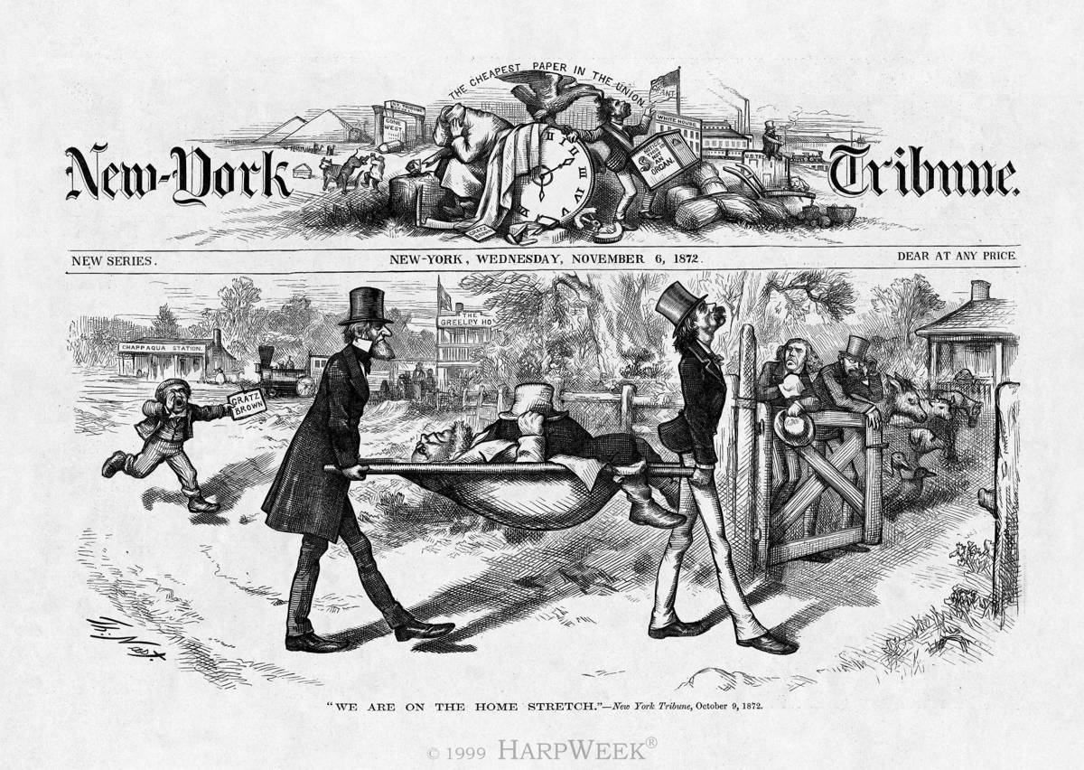
The New Prophet?????

Slide 6
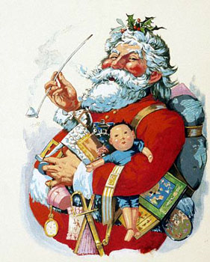
Thomas Nast
Famous cartoonist for Harpers Weekly and NY Illustrated News- “Father of the American Cartoon”
Santa Claus
Republican Party symbol
getting “nasty”
Offered $500,000 to “study” art in Europe by Tweed’s representatives
Tweed and Greeley were his 2 main targets

Slide 7
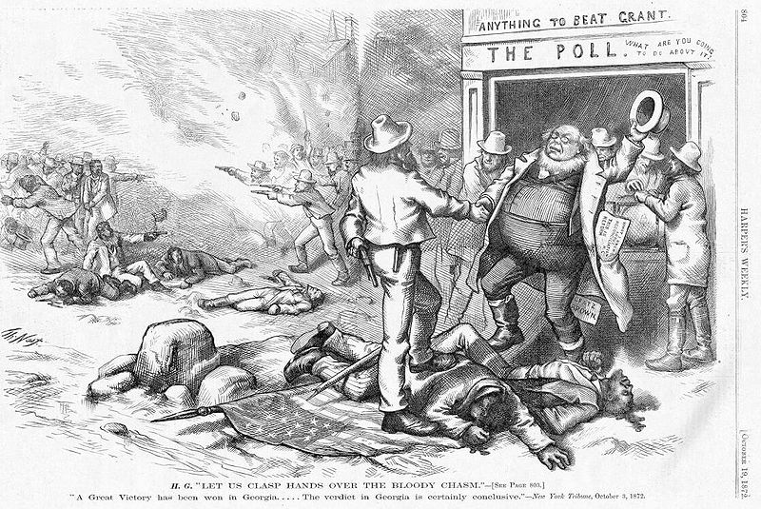

Slide 8
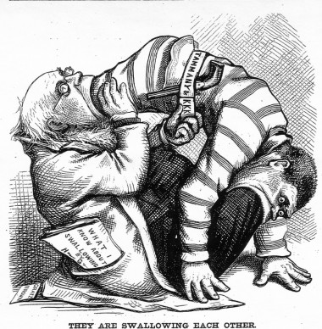

Slide 9
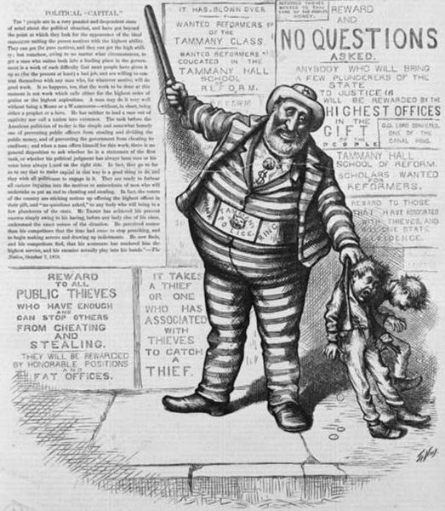
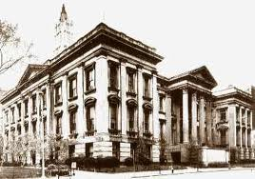
Boss Tweed
Tammany Hall
Eventually becomes NYC Democratic Headquarters
Existed from 1790-1964
“bossism”
Basically runs NYC government
Relationship with Irish immigrants
Fixes elections
Boss Tweed is most famous and corrupt of the bosses
Congressmen, state senator, “volunteer fireman” (Big 6”)
"Stop them damned pictures. I don't care so much what the papers say about me. My constituents don't know how to read, but they can't help seeing them damned pictures!"
$13 million to build NYC Courthouse (double the Alaska Purchase), carpenter got $360,751 for a months work ($5mil), plasterer got $133,187($2mil) for 2 days work
Estimated theft of NYC by Tweed- $2-8 billion in today’s $$
Jailed, release after 1 year, jailed again, escaped fled to Spain, captured there because policeman recognized him from Nast’s cartoons, thought to be a child molester, kidnapper!!

Slide 10
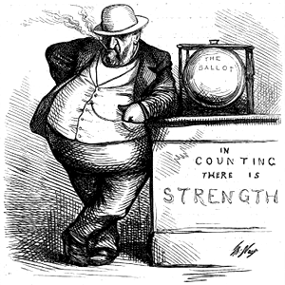

Slide 11
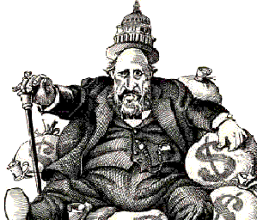

Slide 12
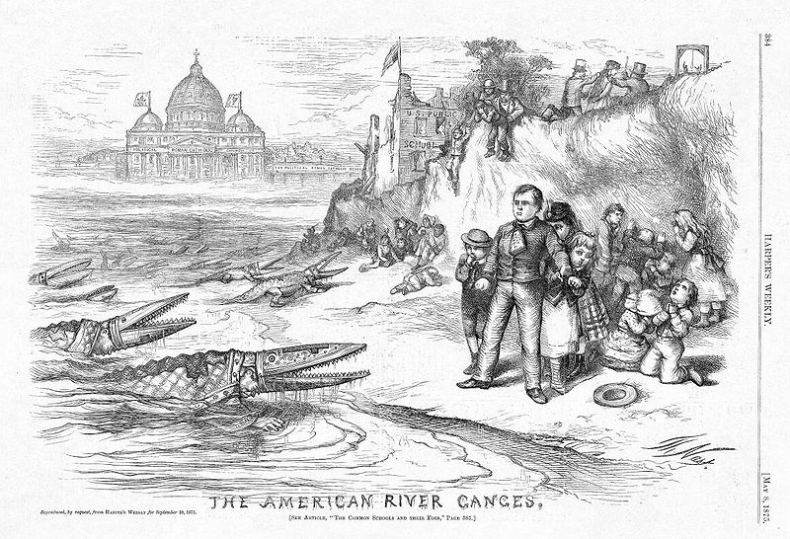

Slide 13
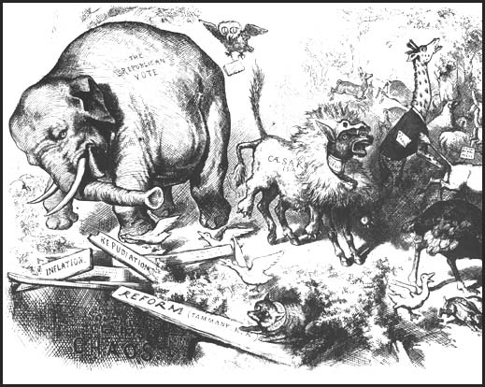

Slide 14
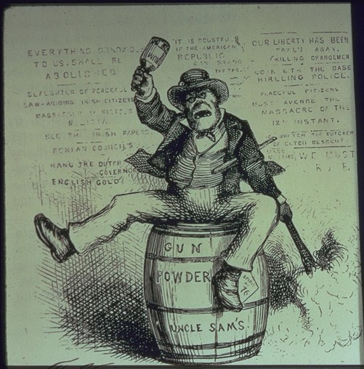
“The Usual Irish Way of Doing Things”

Slide 15
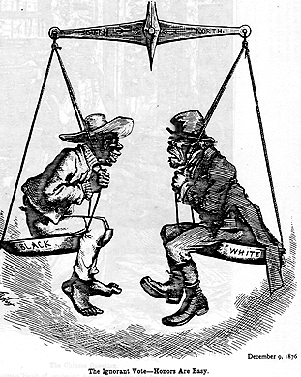
“The Ignorant Vote”

Slide 16
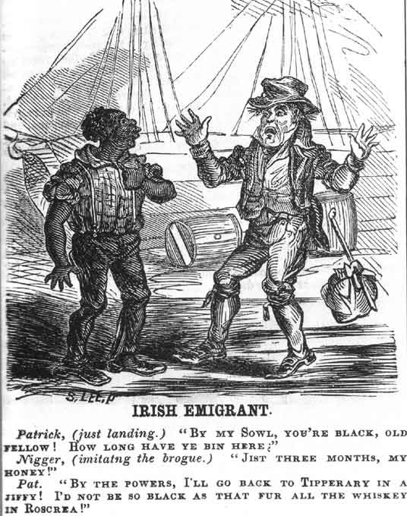

Slide 17
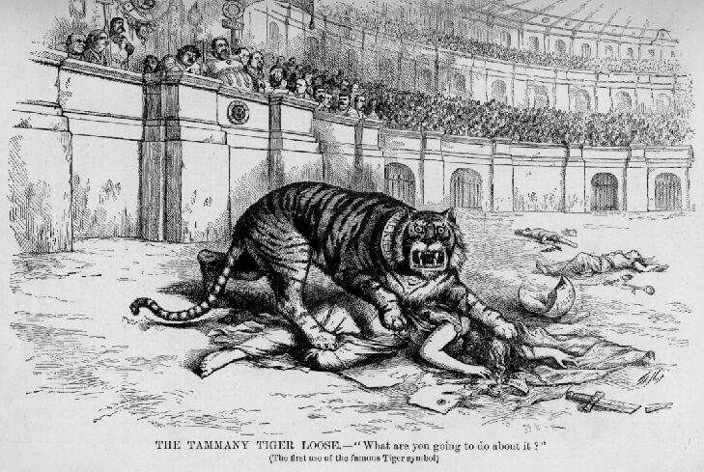

Slide 18
Gilded Age Philosophies
Laissez-faire economics-
“HANDS OFF”- government does not get involved in business. Interference by government would decrease productivity and weaken economic foundations
Social Darwinism-
the strongest business will survive, the weak be damned, its natural. The weak go bankrupt and the strong thrive and get bigger
Algerism- based on Horatio Alger.
An ambitious person will succeed if he works hard, is thrifty, has integrity, follows the rules and has a little bit of luck
Materialism-
the idea that acquiring goods or wealth is one of the most positive pursuits in life. The desire to acquire wealth is a true “American” value
Gospel of Wealth
The belief that the wealthy have a responsibility to combine their economic power with Christian charity. Acquire wealth during your business life, then do philanthropy during retirement.
According to this theory,, who is not responsible for caring for the poor???
The rich do the charity, NOT THE GOVERNMENT!!

